Slide 1
TEXAS REGIONS

Slide 2
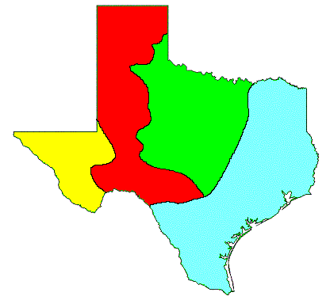
What are the Regions of Texas?

Slide 3
The regions of Texas are…
Gulf Coastal Plain
High Plains
Central Plains
Mountains and Basins

Slide 4
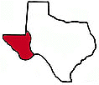
Welcome to the Mountains and Basins!!

Slide 5
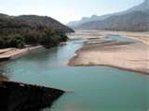
Location
Far west Texas
East border near Pecos River
South border is the Rio Grande
North border is New Mexico

Slide 6
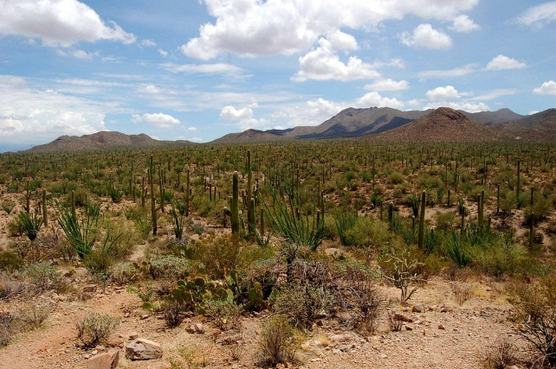
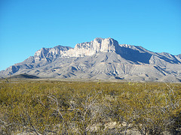
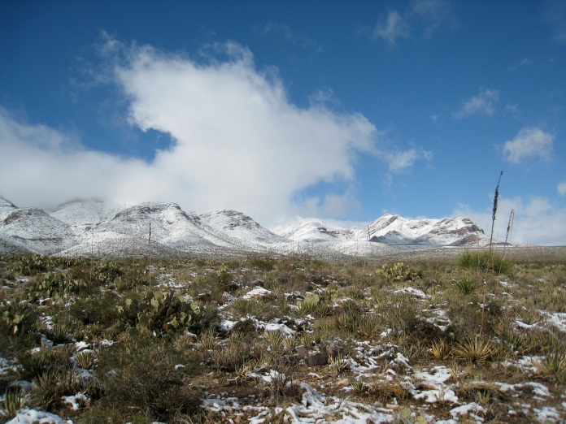
Landforms/Geographic Features
Mountain Ranges: Chisos Mountains, Davis Mountains, Guadalupe Mountains
Guadalupe Peak
Plateaus
Basins
Desert
Pecos River
Rio Grande River

Slide 7

Climate
Driest part of state
8 inches of rain per year in the basins
20 inches of rain per year in the mountains
Hot days, cool nights

Slide 8
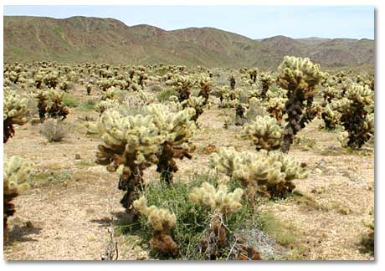
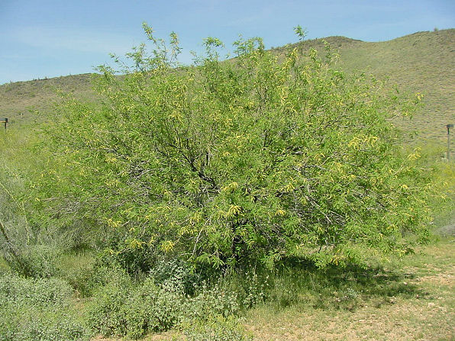
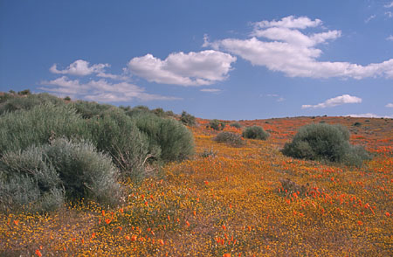
Plants
Chollo Cactus
Mesquite
Sagebrush

Slide 9
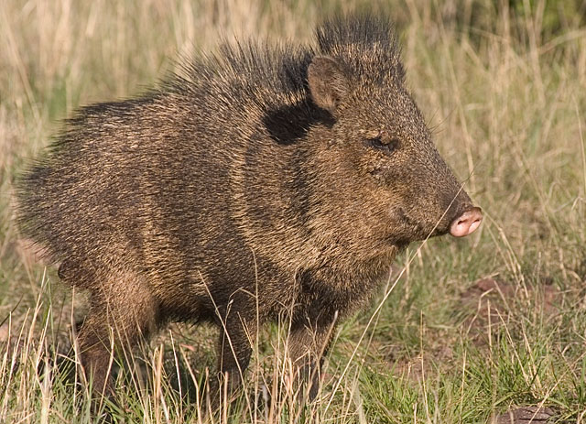
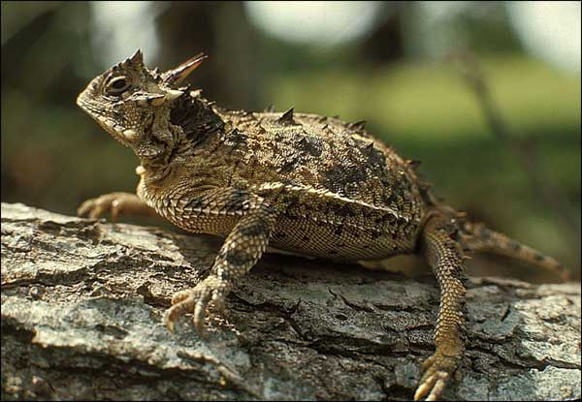
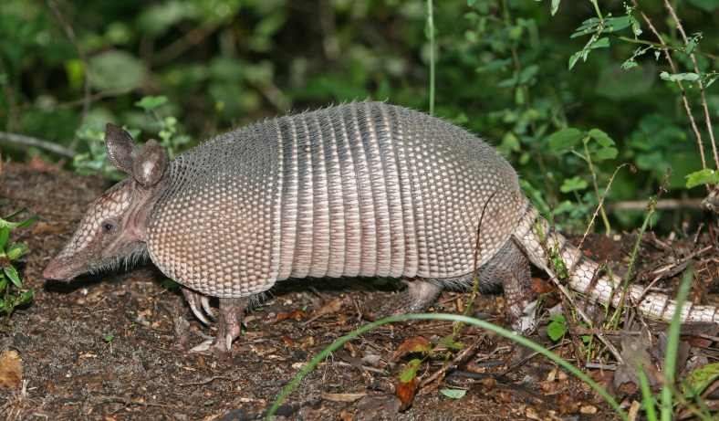
Animals
Javelina
Roadrunner
Grey-banded King Snake
Lizard
Scorpion
Horned Toad
Rattlesnake
Armadillo
Coyote

Slide 10
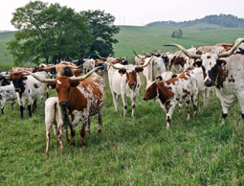
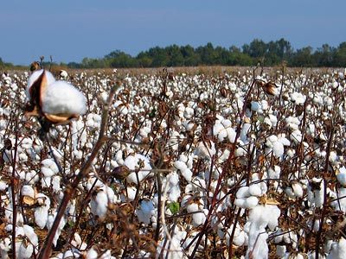
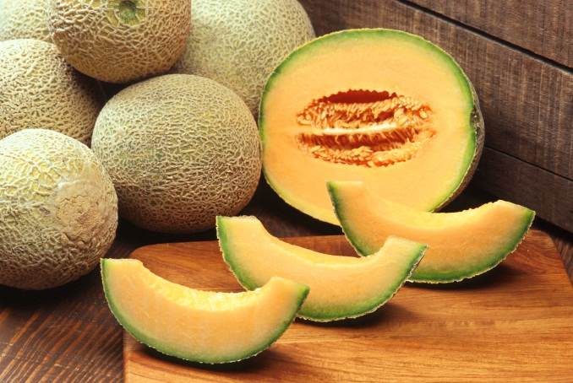
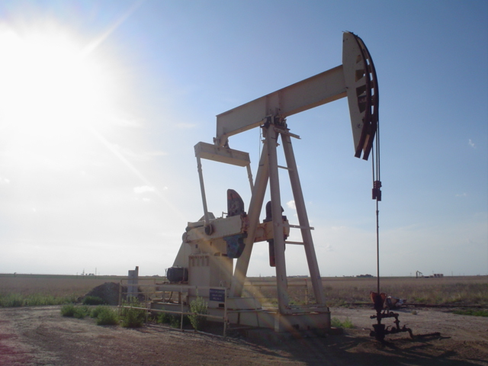
Economics
Ranching - cattle, sheep, goat
Farming - cotton, fruits, vegetables, cantaloupes (irrigation in El Paso and Pecos River Valley)
Oil and gas - part of Permian Basin

Slide 11
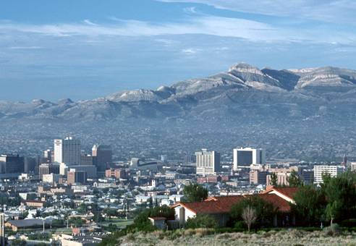
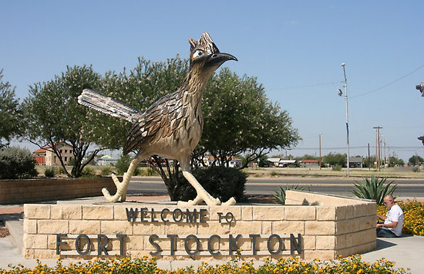
Cities
El Paso
Fort Stockton
Pecos
Presidio
Van Horn

Slide 12
STOP…………….
Our next region we will look at is…..
High Plains

Slide 13
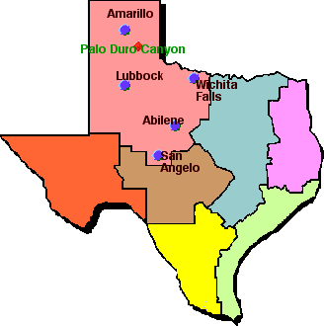
High Plains “aka” Great Plains

Slide 14
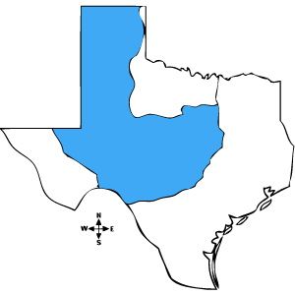
Location of High Plains
Northeast Texas
Colorado and Red Rivers are the borders.

Slide 15
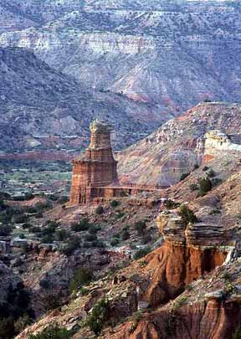
Landforms/Geographic Features
Caprock Escarpment
Edwards Plateau
Stockton Plateau
Palo Duro Canyon
Rolling grassy lands
Thick grasses
Cross Timbers area
Limestone rock
Numerous rivers
Elevation 1,640 feet – 4,920 feet

Slide 16
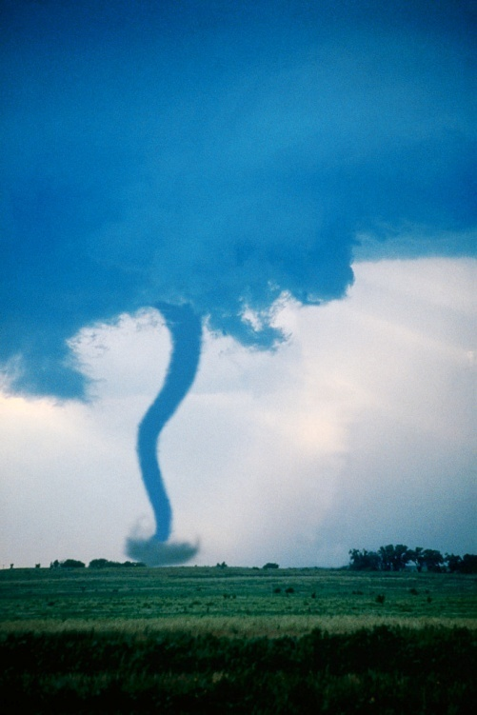
Climate
Coolest temperatures in Texas
12 – 36 inches of rain per year
Tornadoes
Dry air

Slide 17
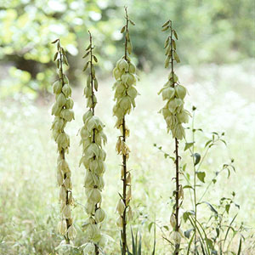
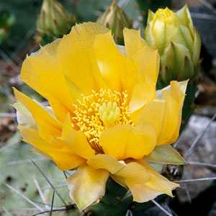
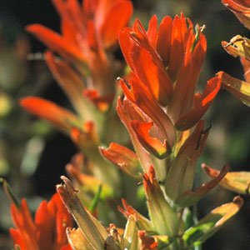
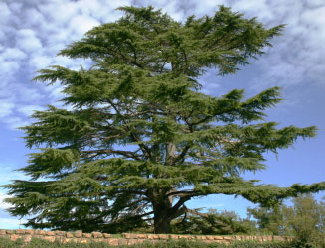
Plants
Grass
Cotton
Wheat
Wildflowers
Prickly pear
Yucca
Indian Paintbrush
Cedar Trees

Slide 18
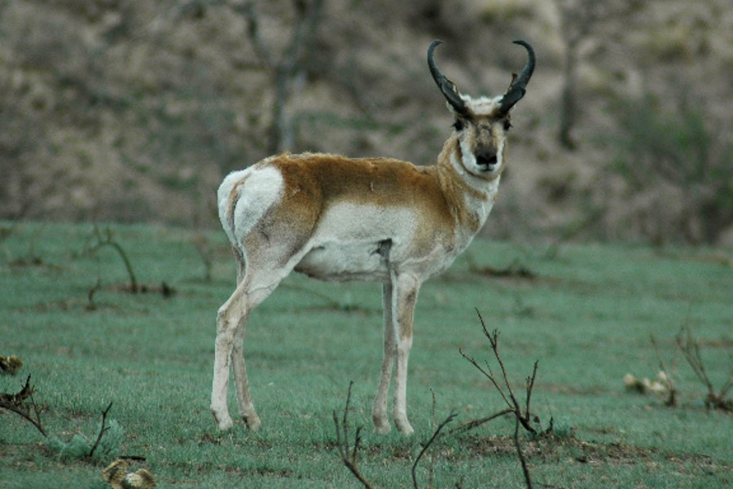
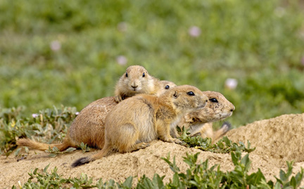
Animals
Mountain Lion
Roadrunner
Prairie Dog
Jackrabbit
Burrowing Owl
Pronghorn
Snakes
Armadillo
Coyote

Slide 19
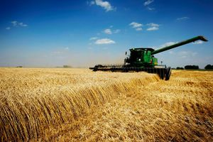
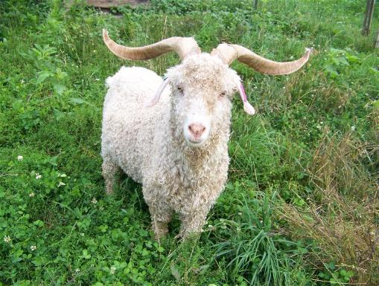
Economics
Ranching - cattle, angora goats (mohair)
Farming – cotton, fruits, vegetables, watermelons, oats
Oil and gas

Slide 20
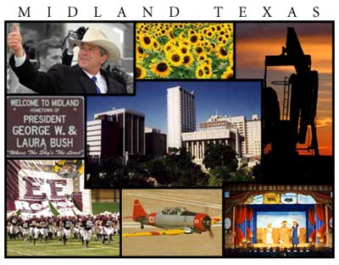
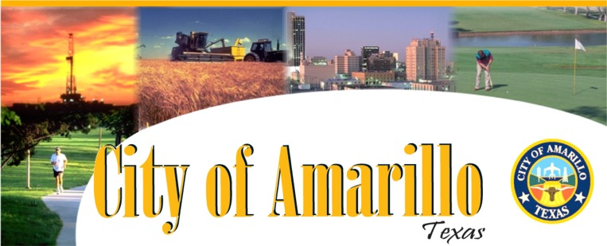
High Plains Cities
Amarillo
Lubbock
Midland
Odessa

Slide 21
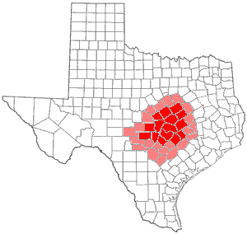
STOP…………….
Our next region we will look at is…..
CENTRAL PLAINS

Slide 22
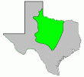
Central Plains

Slide 23
Location of Central Plains
Bordered on the north by the Red River
Bordered on the west by the Caprock Escarpment
The Colorado River runs through the southern edge of the Central Plains

Slide 24
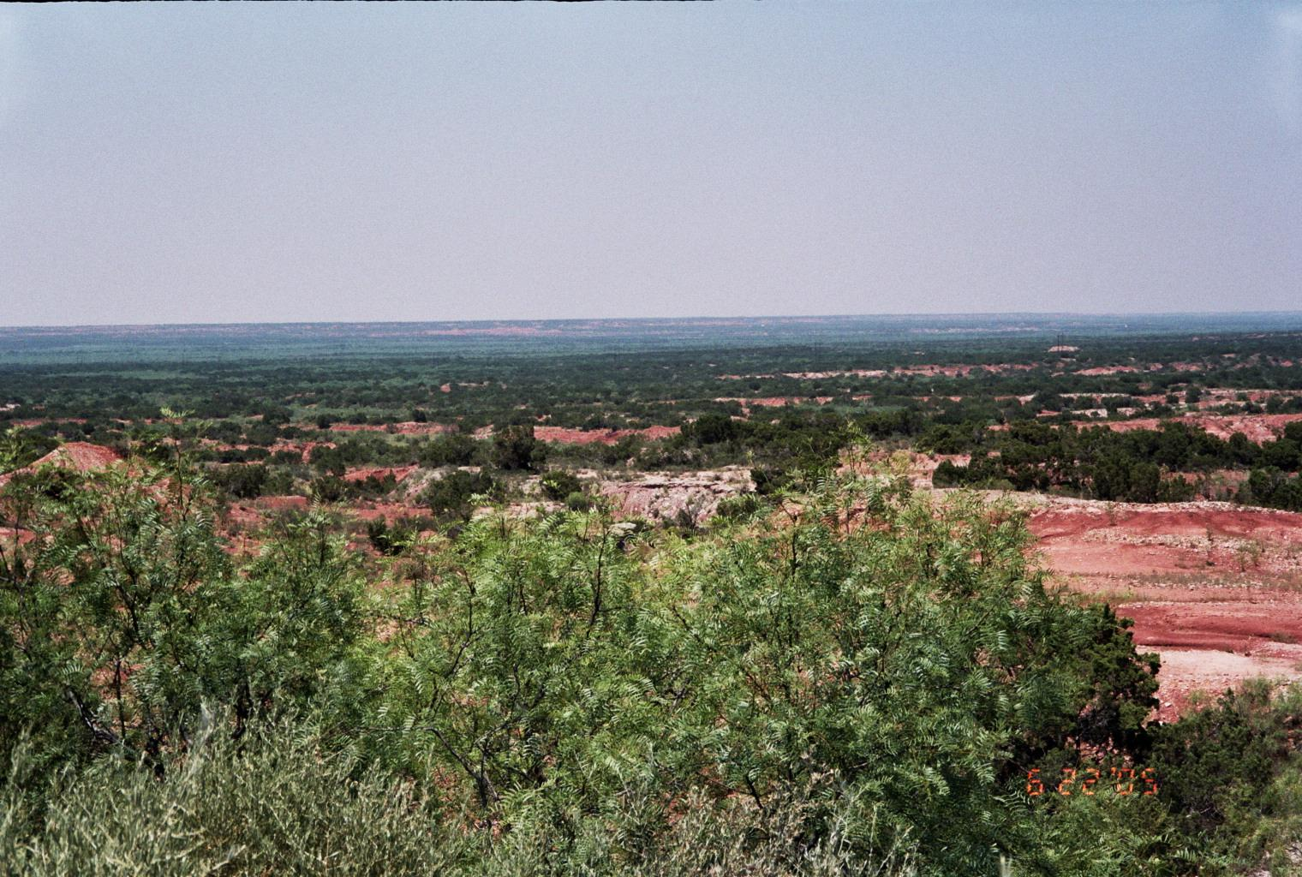
Landforms of Central Plains
Caprock Escarpment
Red River
Brazos River
Colorado River

Slide 25
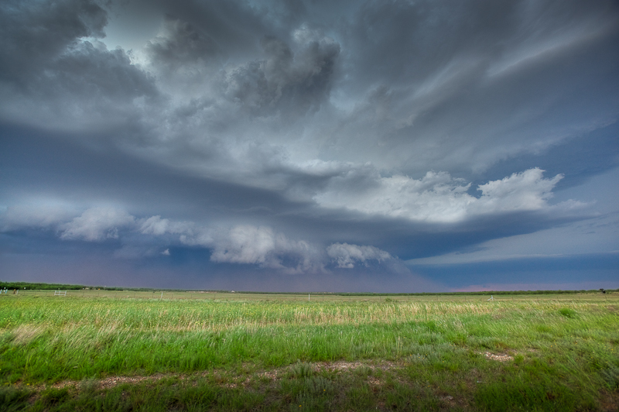
Climate
12 – 36 inches of rain per year
Tornadoes
Dry air

Slide 26
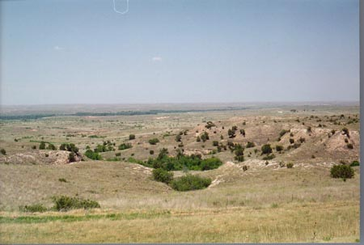
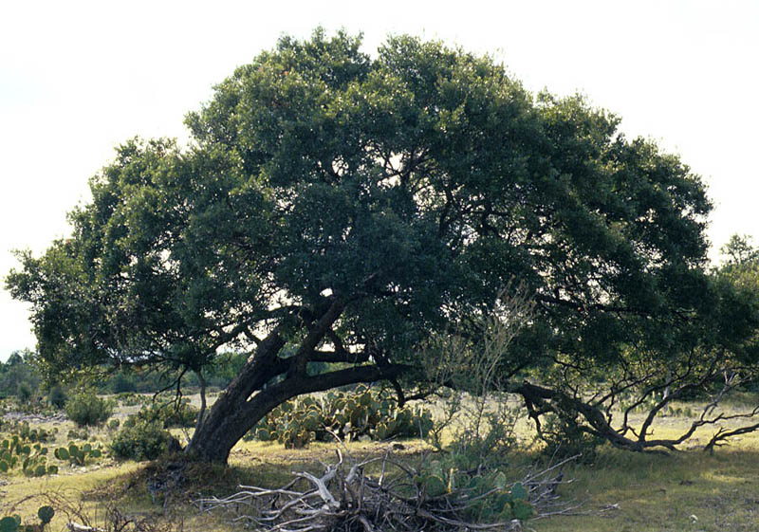
Plants
Grass
Cotton
Wheat
Prickly Pear Cactus
Texas Oak Trees
Mesquite Trees
Bald Cypress Trees

Slide 27
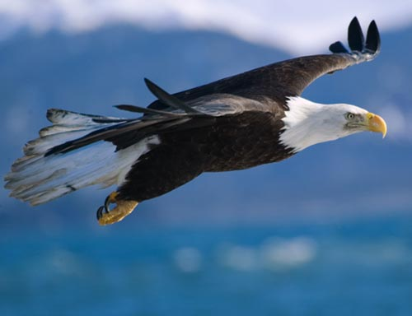
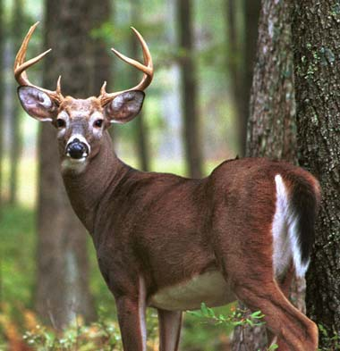
Animals
Bald Eagle
Armadillo
Horned Lizard
Bobcat
White-tailed deer
Screech Owl

Slide 28
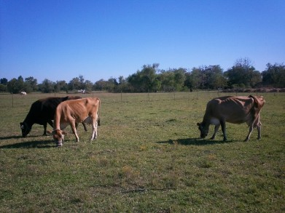
Economics
Ranching – dairy cattle
Farming – cotton and grains
Oil and gas
Coal

Slide 29
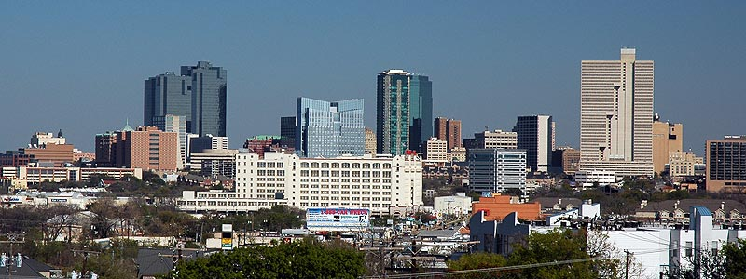
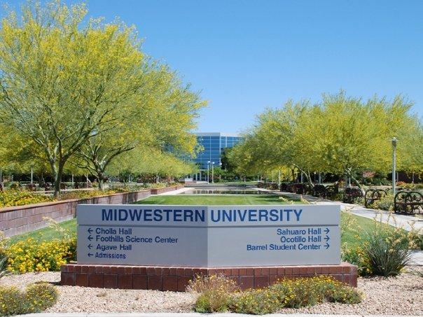
Cities
Wichita Falls
Abilene
Killeen
Burnet
Ft. Worth

Slide 30
STOP!!!!

Slide 31
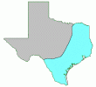
Coastal Region

Slide 32
Location of Coastal Region
Covers 1/3 of the land of Texas
Northern border is Oklahoma and Arkansas
Eastern border is the states of Louisiana and Arkansas
Southeast border is the Gulf of Mexico
Southwest border is the Rio Grande River
West border is the Balcones Escarpment

Slide 33
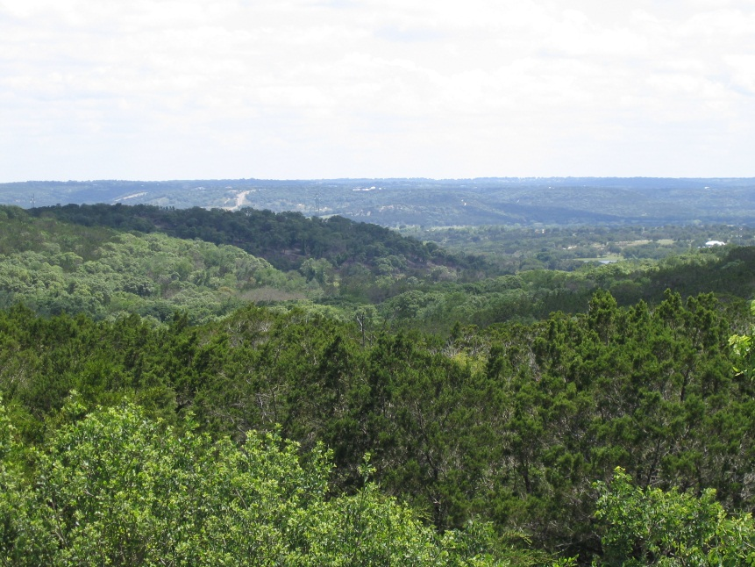
Landforms…..
Hill Country - an area of hills along the Balcones Fault and is a transitional area between the High Plains and the Gulf Coastal Plains
Balcones Escarpment
Numerous rivers including: Sabine River, Neches River, Trinity River, Brazos River, Colorado River, Guadalupe River, San Antonio River, Nueces River, and Rio Grande River
Gulf of Mexico
Elevation: 0 feet – 1,640 feet

Slide 34
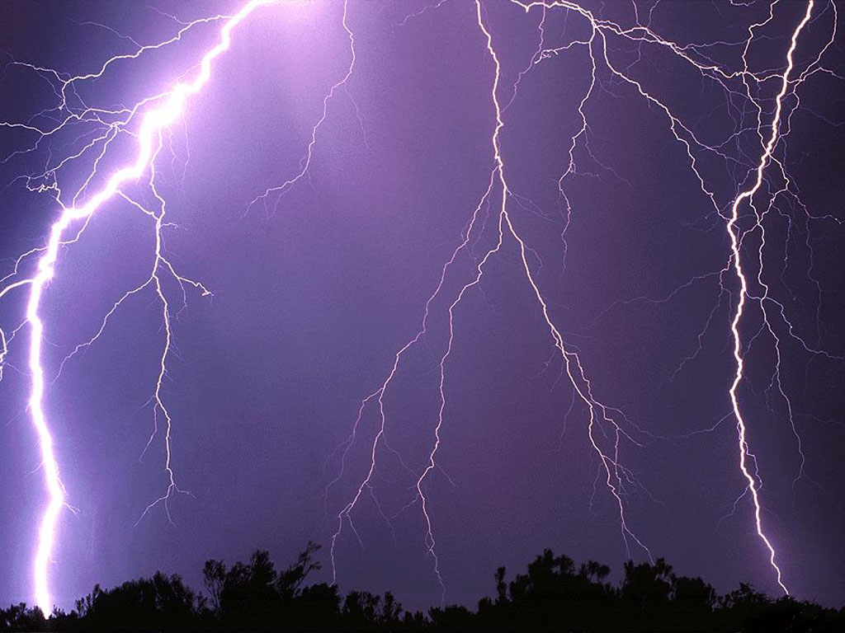
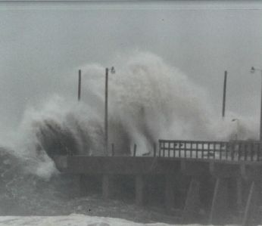
Climate…….
Hot and humid
12 – more than 48 inches of rain per year
Tornadoes
Hurricanes

Slide 35
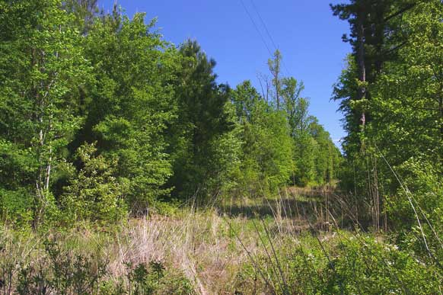
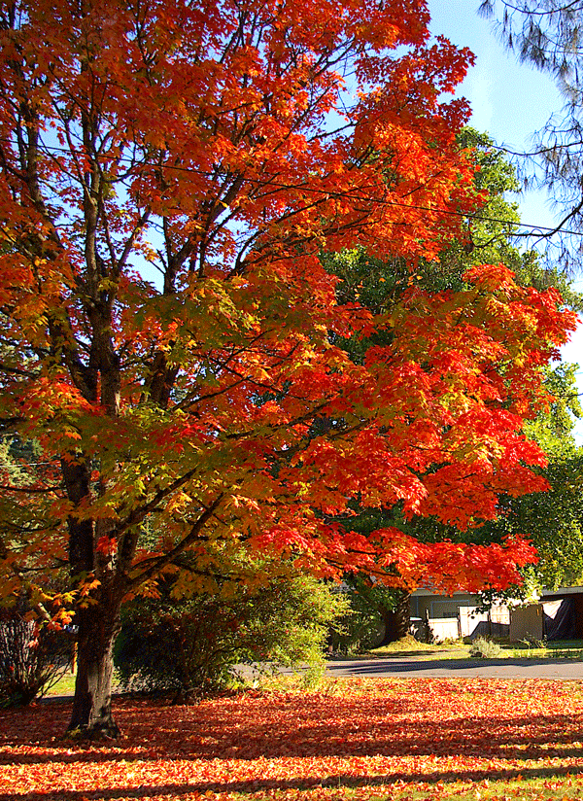
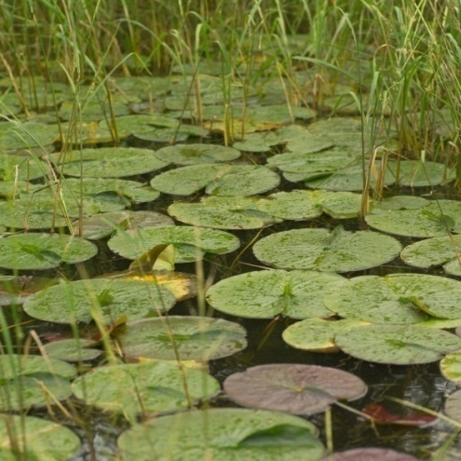
Plants
Numerous trees including : pine, oak, maple, and ash.
Tall grasses
Wildflowers
Holly
Red Mulberry
Red Chokecherry
Water Lily
Cattails

Slide 36




Bluebonnets
Indian Blanket
Standing Cypress
Blue Sage

Slide 37


Animals….
Hundreds of birds including: quail,
hawks, owls, and bald eagles
Fresh water fish including: catfish,
trout, and bass
Sea life found in the Gulf of Mexico:
oysters, crab, shrimp, dolphins, sharks
White tail deer
Armadillos
Foxes
Beaver
Skunks
River otters
Bobcats
Alligators in the marshes!!! Some weigh up to 500 lbs!!!
River Otters
Alligator

Slide 38


Economics
Farming – oranges, grapefruit, vegetables, cotton, grain
Ranching – cattle
Fishing – fish and shrimp
Oil and gas
Shipping

Slide 39



Cities
Texarkana
Dallas
Waco
Austin
San Antonio
Corpus Christi
Houston
Galveston
Laredo
Brownsville

